Slide 1





Consumers sentiment analysis
Presented By- Afrin Hayat

Slide 2
Index
Introduction
Methodology
2.1 Proposed Approach
2.2 Lexicon
2.3 Data Collection
2.4 Classification Techniques
2.5. Evaluation model parameters(Accuracy, Precision, Recal1, Sentiment
Distribution, Algorithm Efficiency, Dual Algorithm Approach)
2.6 Implementation
Results
Discussion

Slide 3
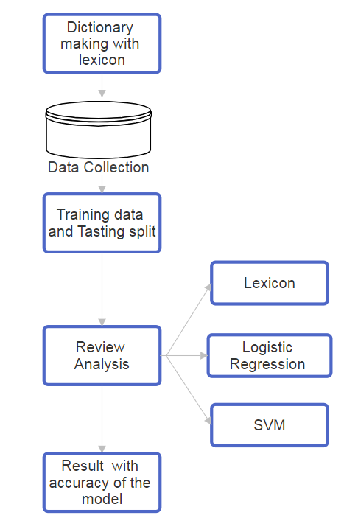
Methodology
Proposed Approach →
Reviews play a vital role in marketing of a particular product
A model through the opinions of customers about Apple products→

Slide 4
Methodology (Cont.)
Lexicon →
Lexicon-based method simplifies sentiment classification in this study.
Lexicon-based method for categorising words.
Major Step - Classifying words for sentiment analysis.
Lexicon = dictionary for sentiment analysis.
Comparison against expert-defined dictionary for polarity determination (positive, negative, neutral).
Lexicon with 8222 entries.
Positive words designated as 1,
Negative as -1,
Neutral as 0.

Slide 5
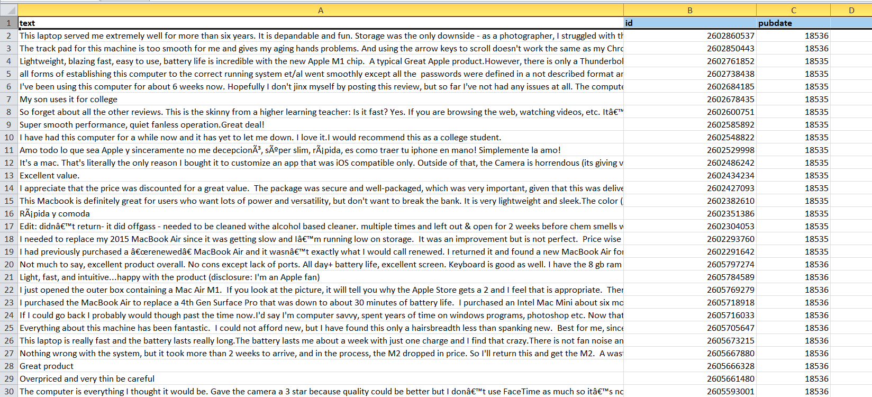
Dataset
EXAMPLE

Slide 6
Data Collection and Processing
Step 1: Create a Clean DataSet
From where we collect Data
Dataset contains around 5540 data, which is collected from–
mainly blogs
open sources and
social networks
1

Slide 7
Data Collection and Processing
Step 1: Create a Clean DataSet
How we make it CLEAN
Removes all unnecessary data. For Example–
Non ASCII characters. i.e emoji
Any type of punctuation marks.
All unrelatable fields and take consideration only Comments, ID and date.
1

Slide 8
Data Collection and Processing
Step 2: Create Dictionary using Lexicon
How to Do It
We divide words into Three categories and set a point for them.
Positive Words (Points: +1)
Negative Words (Points: -1)
Neutral Words (Points: 0)
2

Slide 9
Data Collection and Processing
Step 2: Create Dictionary using Lexicon
Example
Words | Points
Problem | -1
Excellent | +1
Use | 0
Worst | -1
Word | Points
No | -1
Wonders | +1
Color | 0
Disappointing | -1
2

Slide 10
Data Collection and Processing
Step 3: Making Decision about Customers Opinions
Process: how to do it
Sum up points of all word in customers opinions, let's say it as SumPoints. Now,
3
Condition | Decision
SumPoints > 0 | Positive Review
SumPoints < 0 | Negative Review
SumPoints = 0 | Neutral Review

Slide 11
Data Collection and Processing
Step 3: Making Decision about Customers Opinions
Example: Consider the Comment
“omg! this is such an incredible product. perfect keyboard, perfect weight, perfect battery life and it doesn't get hot most of the times…”
Here, __ -> Positive word, __ -> Negative Word, __ -> Neutral Word
SumPoints = (6 - 2) = 4 > 0 So, The Comment is a Positive Review.
3

Slide 12



Evaluation Model Parameters
1. Accuracy: Accuracy can be defined as the probability of the number of correct predictions made by the classifier.
- LR (Logistic Regression) : 82.853% and SVM (Support Vector Machines ): 82.942%
2. Precision: Precision measures how accurate our positive predictions were.
- LR: 81.65% and SVM : 82.85% (in identifying positive sentiments.)
3
33. Recall: Recall measures what fraction of the positives our model identified
- -LR: 82.85% and SVM :82.94% (capturing a substantial portion of positive sentiments.)

Slide 13
Implementation
4. Sentiment Distribution:
Lexicon:
Pos: 72.2%
Neg: 7.0%
Neu: 20.8%
LR and SVM:
Pos: 73.47%
Neg: 6.77%
Neu: 19.77%
Majority positive sentiments.
5. Algorithm Efficiency:
SVM > LR for high-dimensional data.
Lexicon > ML in efficiency.
6. Dual Algorithm Approach:
LR and SVM integration for comprehensive consumer sentiment understanding.

Slide 14
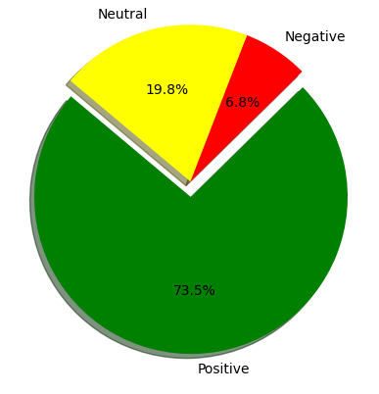
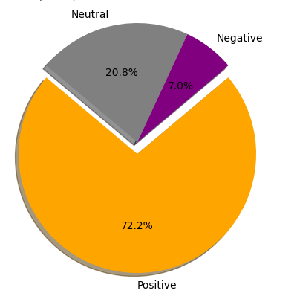


Result (Count of Review Types)
Model name | Positive | Negative | Neutral
Logistic Regression | 73.47% | 6.77% | 19.77%
SVM | 73.47% | 6.77% | 19.77%
Lexicon | 72.2% | 7.0% | 20.8%
LR and SVM
Lexicon

Slide 15
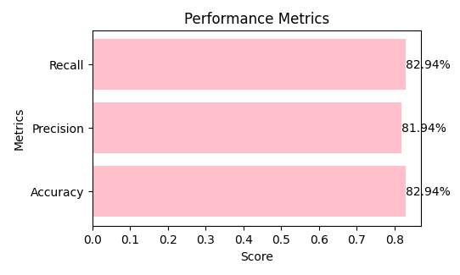
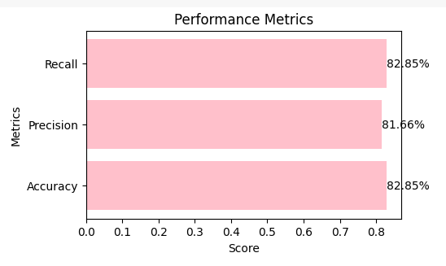
Result (Accuracy of Different Process)
Model name | Accuracy | Precision | Recall
Logistic Regression | 82.85% | 81.66% | 82.85%
SVM | 82.94% | 81.94% | 82.94%
Lexicon | 100% | 1% | 1%
Table 2: Testing results of the pre-trained models.

Slide 16
Result (Top Scoring Comments)
Sentiment | Scores | Review
Positive | 23.00 | the 2020 macbook air bigsur os is one of the newest computers on the market at the moment and one of apples best designs.....
 | 23.00 | nice goodmacbook review apple has created many technological wonders throughout the time of the business, and the mac is no exception......
 | 26.00 | update 12-15-2020 - after three weeks, i'm still really impressed with the m1 macbook air/8.....
 | 28.00 | i've had a variety of apple equipment in my life-- but also microsoft surface, surface laptops,.....
Negative | -8.00 | i've owned this laptop for a year and a half, and felt compelled to take time out of my frantic day
 | -7.00 | serious problem with the lower mic, after spending all that money in this faulty crap.....
 | -5.00 | ive owned macs for over 25 years and this is the worst ive ever owned.....
 | -4.00 | very very bad product accessories very cheap quality packing .....

Slide 17
Thanks!

